Slide 1
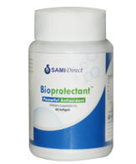
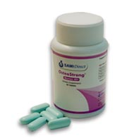
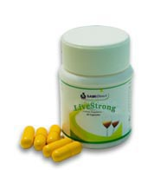
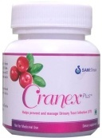
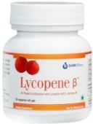
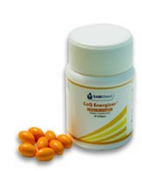
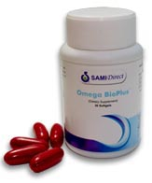
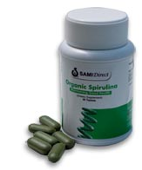
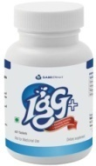
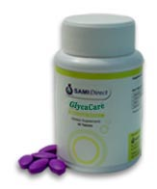
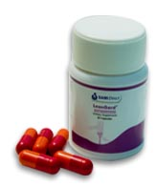
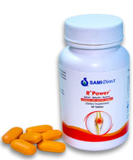
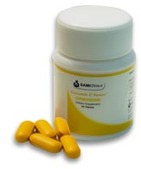
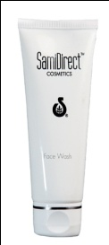
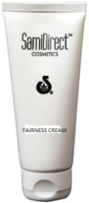
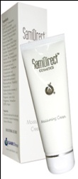
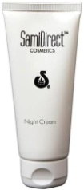
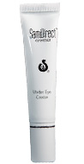
Cellular Aging
Osteoporosis
PREVENTION
Liver Damage
Urinary Tract Infection
Cancer
NUTRITION
Cellular Energy
Nerves & Blood
46 Essential Nutrients
Immunity
Diabetes
MANAGEMENT
Obesity
Joint Pain
Overall Wellness
Face Wash
Fairness Cream
ANTI-AGING SKIN CARE
Night Cream
Moisturizing Cream
Under Eye Cream

Slide 2
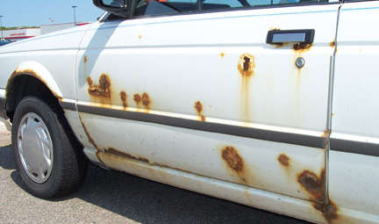
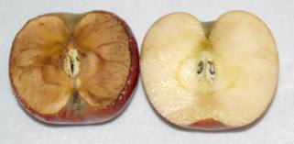

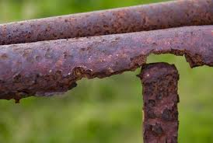


Slide 3
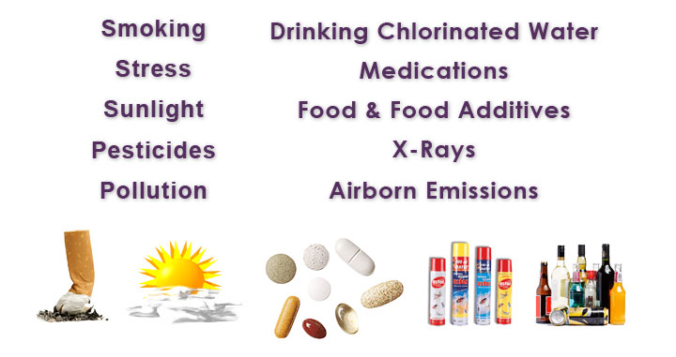

Slide 4
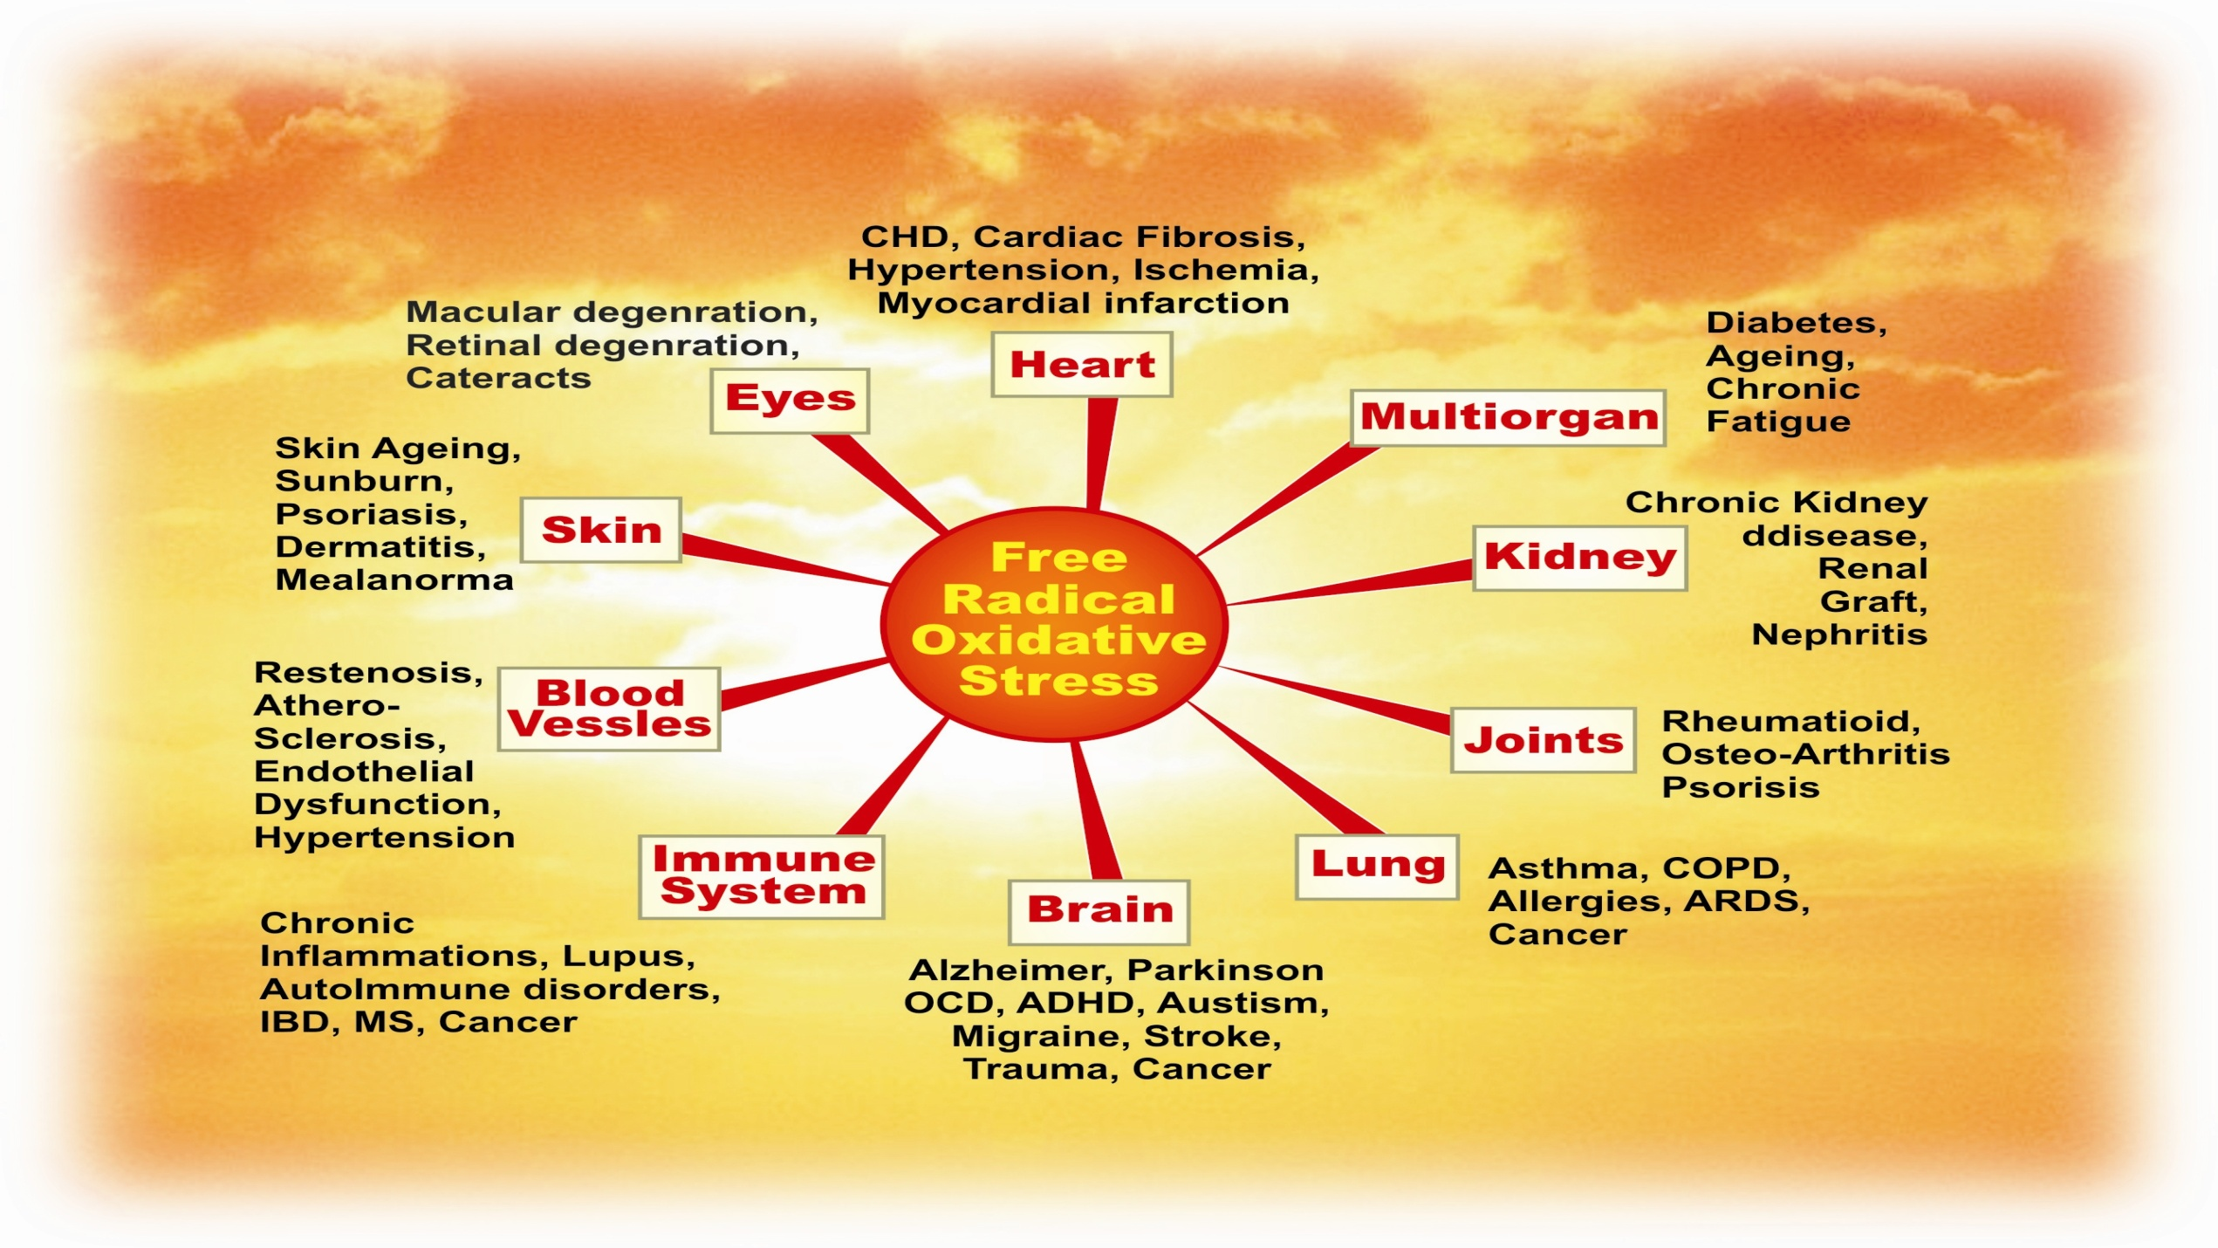
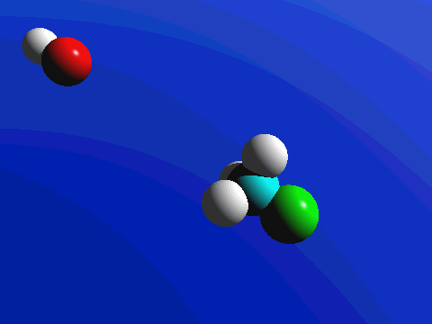
FREE RADICALS (OXIDATION)
ANTI OXIDANTS with high ORAC value.

Slide 5

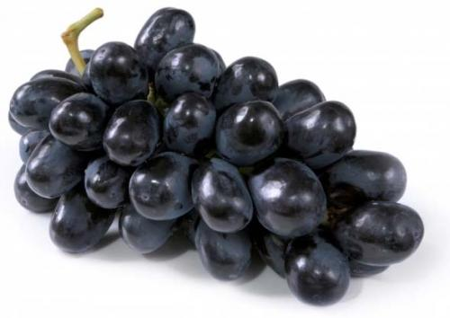
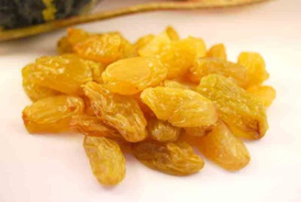
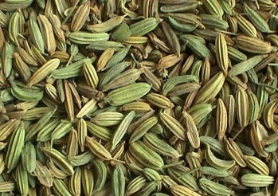
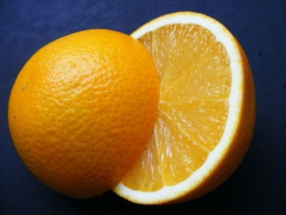
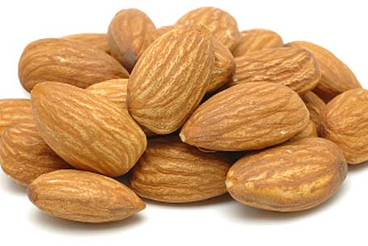
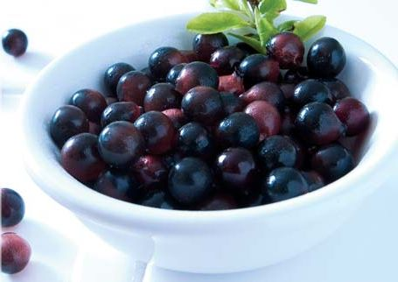
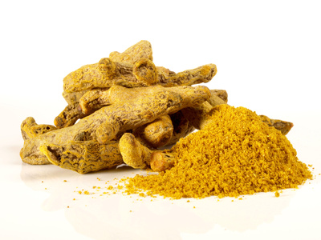
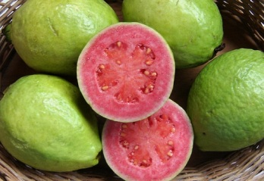
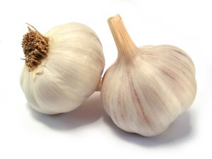
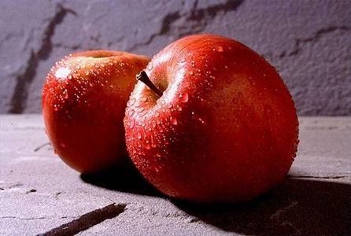
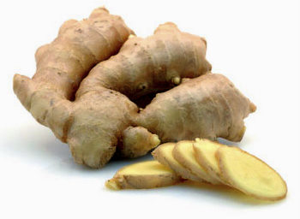
1,746
3,406
50,372
1,819
4,454
102,700
1,990
5,708
3,049
14,840
127,068

Slide 6
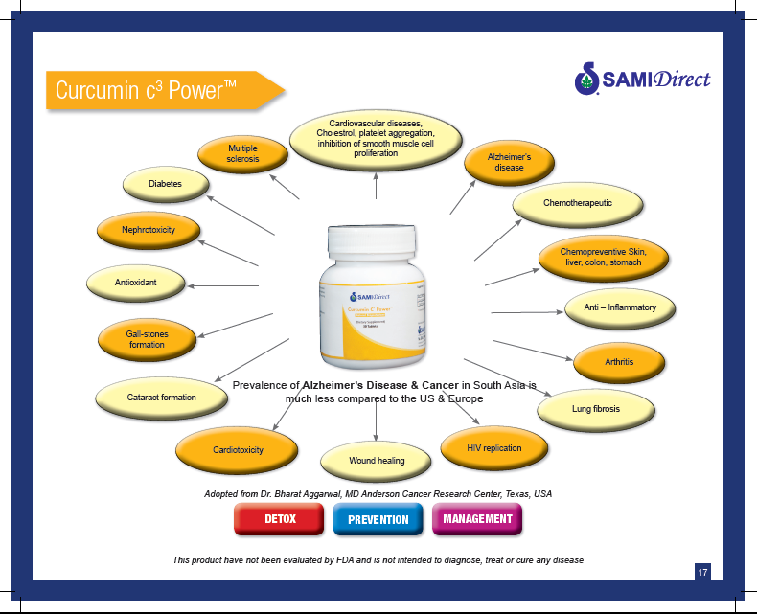

Slide 7
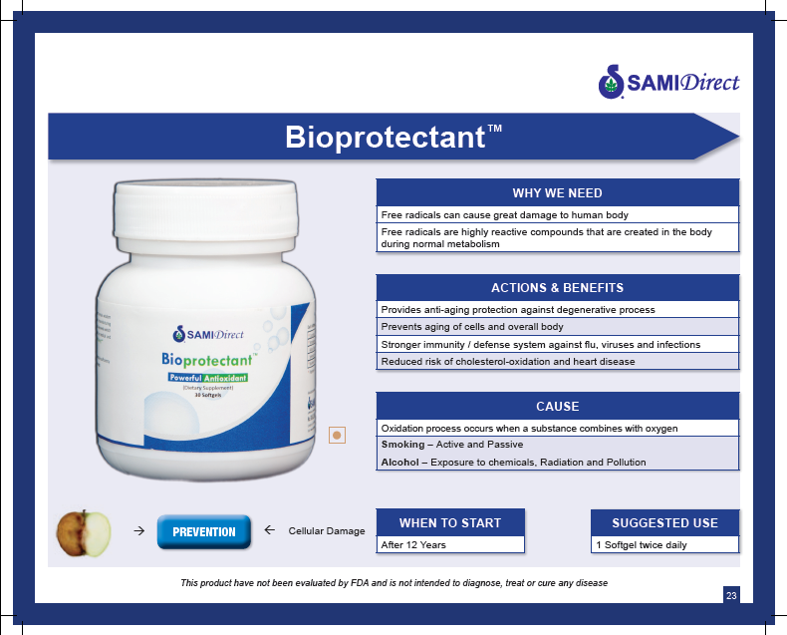

Slide 8

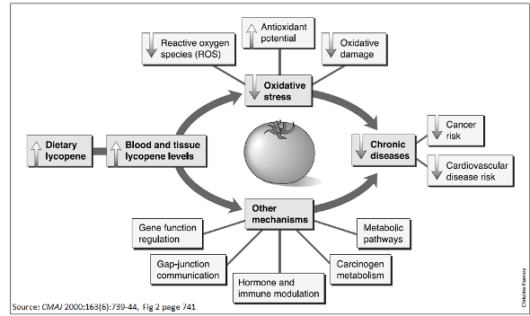

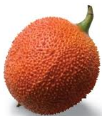

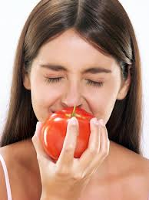
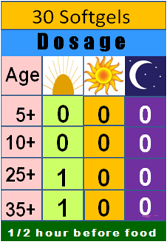
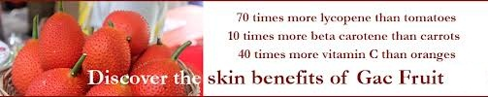
Prevents
Various Types of Cancers
Chinese cucumber,
Chikka Halasu.

Slide 9
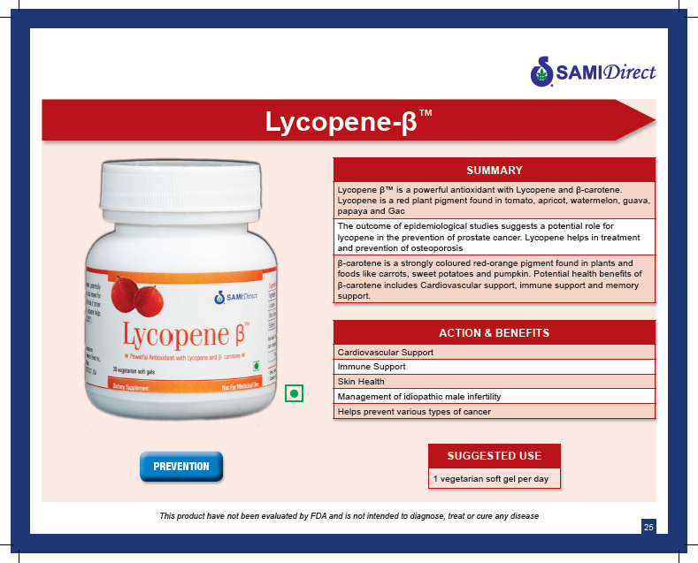

Slide 10


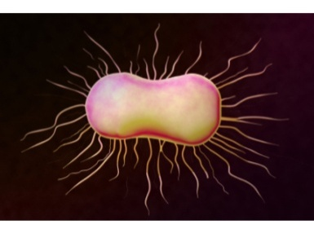

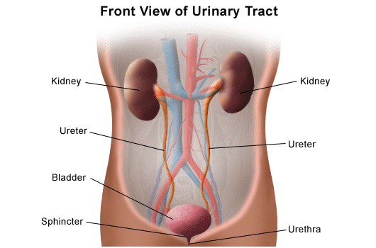


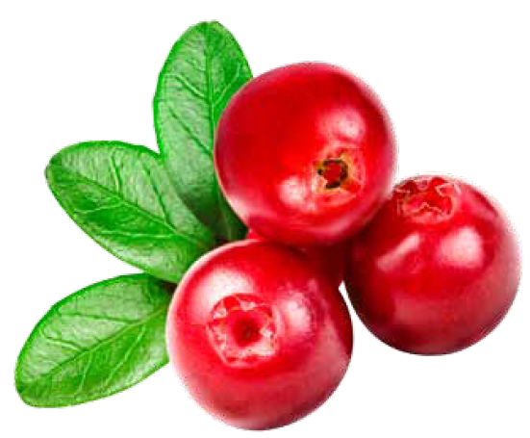
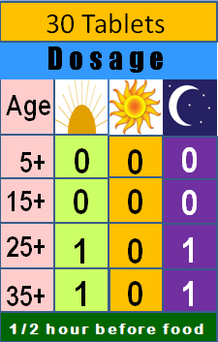
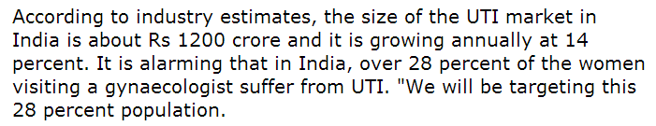
Prevents
Urinary Tract Infection
Cranberry

Slide 11
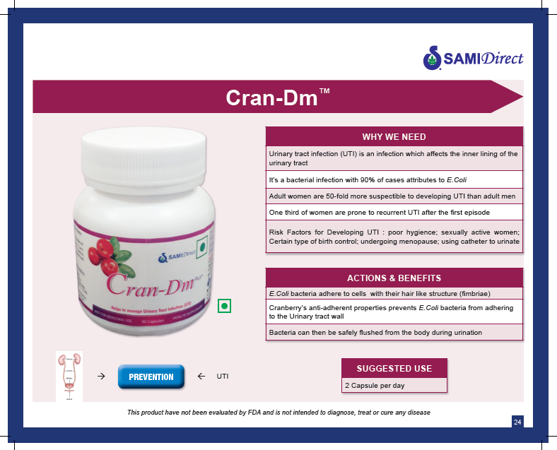

Slide 12

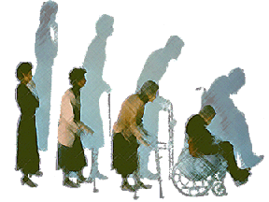






Prevents
Degeneration
of Bones in WOMEN
PHYTOESTROGENS
Soy extract
Red clover extract

Slide 13


Slide 14








Provides Nutrition for blood & nerves
Agase beeja
Sl. No. | Omega fatty acids | Percentage (%)
1 | Omega 3 fatty acids | 40 - 60
2 | Omega 6 fatty acids | 5 - 20
3 | Omega 9 fatty acids | 15 - 30
Olives

Slide 15


Slide 16







2.5 Kg = 60 mg CoQ10
Provides Energy
for Vital Organs
Anyone over 40, should take at least 60 to 100 mg of CoQ10 every day.
2.5 Kg = 65 mg CoQ10

Slide 17


Slide 18








Prevents
Degeneration
of the Liver
Nela Nellikai

Slide 19


Slide 20








Provides all 46 essential Nutrients

Slide 21


Slide 22



Slide 23









Relief, Rebuilds, Restores
Guggula Mara
Boswellia
Glucosamine
Curcumin

Slide 24


Slide 25









Healthy Management of Diabetes
SILBINOL(kino tree)
(Kempu Honne Mara)

Slide 26


Slide 27


Slide 28













Burns Excessive Fat
Stops New Fat Formation
28

Slide 29


Slide 30

“Vita-essentials”
Unique blend of multivitamin and mineral complex, made more effective with the addition of “bioavailability enhancers”

Slide 31


Slide 32


Slide 33


Slide 34


Slide 35


Slide 36


Slide 37


Slide 38


Slide 39

Thank you for your time and attention
We Wish you…………

